Slide 1
Everybody’s Free To Wear Sunscreen
“If I could offer you only one tip for the future, sunscreen would be it The long-term benefits of sunscreen have been proved by scientists
Whereas the rest of my advice has no basis more reliable Than my own meandering experience, I will dispense this advice now”

Slide 2
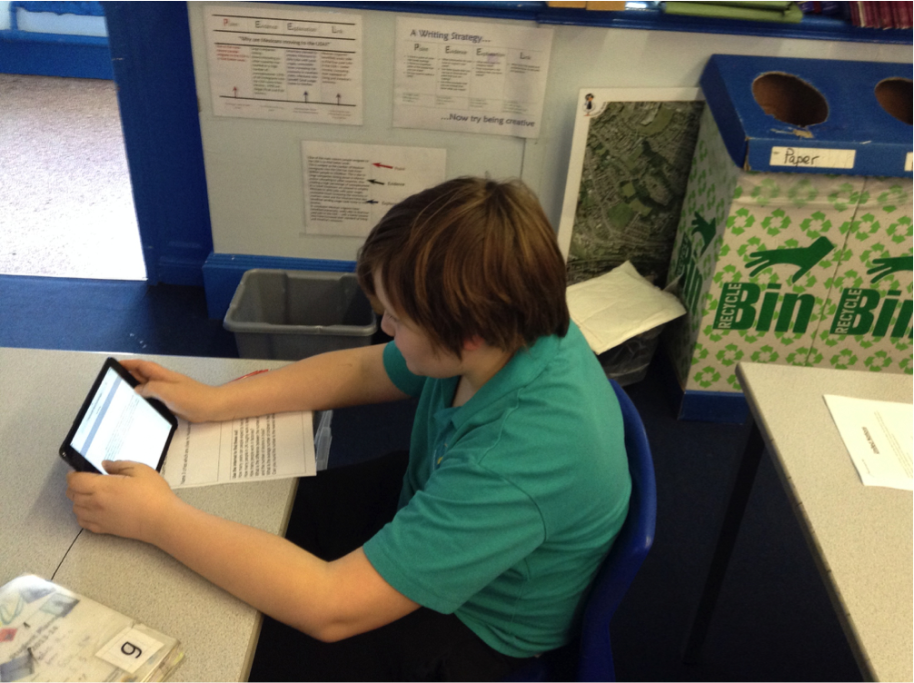
Practical uses of ICT in school: The good, the bad and the day to day
Stephen Higgins
Teacher of Humanities (Geography specialism)
Aspire Award Development
Royds Hall Community School
Teacher for five years.
PGCE Geography, University of Cumbria
shiggins@roydshall.org
@ste_higgins_
www.letsbeinventive.co.uk
www.aspireaward.co.uk

Slide 4
Colours and fonts
opendyslexic.org
Notes:
Powerpoint Presentation Tips for Teachers and Pupils
http://www.belb.org.uk/downloads/i_epd_presentation_tips_for_teachers_pupils.pdf

Slide 5
Forget the memory sticks!
Microsoft One Drive
Drop Box
Google Drive
Apple iCloud
Portable hard disk

Slide 6
Behavior Management
“Big Brother is watching you”. George Orwell
Work the room
Stand at the back
Use Google Docs (More on that later)
Students will paly up because they don’t know what they are dong (This is the internets fault)
RAF: Menwith Hill Harrogate

Slide 7
Research…

Slide 8
Data Protection
Parents evenings
Don’t put SIMS on the board
Keep student data on your school PC
Don’t keep things logged in
Lock your screen

Slide 9
Day to day lessons
PowerPoints annotations
Smart Board and Promethean
Touch Screens
iPad and Laptops
Get a clicker
Record your homework as a podcast
Watch your video clips first…and download them
Clipconverter.cc

Slide 10
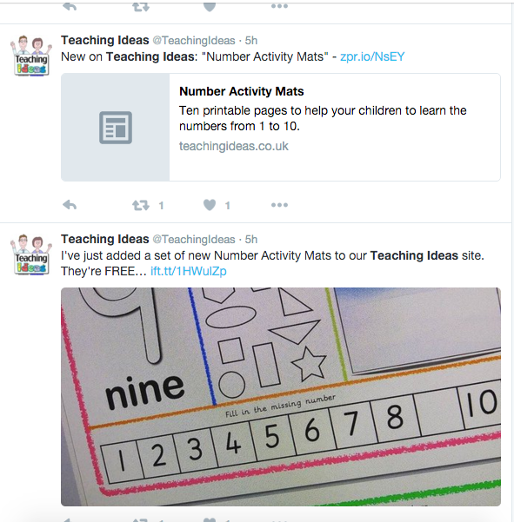
Social Networking
Use Twitter for resources
Twitter for Twitchy Teachers
Facebook
Blogging
People to follow on Twitter:
@TeachingIdeas
@ShellTerrell
@headguruteacher
@TeacherToolkit
Notes:
http://www.esafety-adviser.com/twitchy_twitter/

Slide 11
Share your information
Google Docs is your friend!
Mark sheets
Schemes of work
Intervention lists
Student work

Slide 12
Day to day tools
Countdown timer
Online Stopwatch
Show my homework
Classtools
Check the reading age (Read Able)

Slide 13
CLassDojo
Great behavior management tool
Only use first names

Slide 14
Using tablets and phones
Take photographs of students work.
Don’t use your own phone!
Encourage students to use their phones
QR codes (Information gathering, ‘bases’ style investigations, ‘Take Away’ homework's)
Photograph your homework
Tweet me
Encourage parents to get involved

Slide 15
Software to use
Plickers
Socrative
KAGAN Tools
Google Earth
Scribble Maps
Book Creator
Bitstrips
GCSE Pod
Examtime Mind Maps
Skitch (iOS)
iMovie

Slide 16
Killing the copy and paste culture
Make them write in books
Publicly challenge all copy and pasted work
Ask the student: “What does the word empirical actually mean?”
Students will spend more time removing the Hyperlink from a Wikipedia article than actually writing it.
Copy and paste a section of the text into Google
Check the reading age of the website
Have a list of pre-defined websites
Footnote: Google Translate

Slide 17
TES Resources
Contribute
Time spent searching vs time spent doing
Always, always check through the work first
Beware paying

Slide 18
One more thing…
Keyboard shortcuts:
Ctrl + V Paste
Ctrl + C Copy
Ctrl + X Cut
Ctrl + Tab Switch window
Ctrl + S Save
Ctrl + P Print
Libre Office – a free alternative to Microsoft Office.
Podcasts whilst you mark
It is perfectly ok to not use ICT
Split your screen
You must teach digital literacy
Your computer will allow a constant flow of new ideas.

